Slide 1

Air Pollution and Respiratory Diseases
GROUP MEMBERS: Jessica E, Ariana G, Loraine G, Paul S, Deborah D

Slide 2
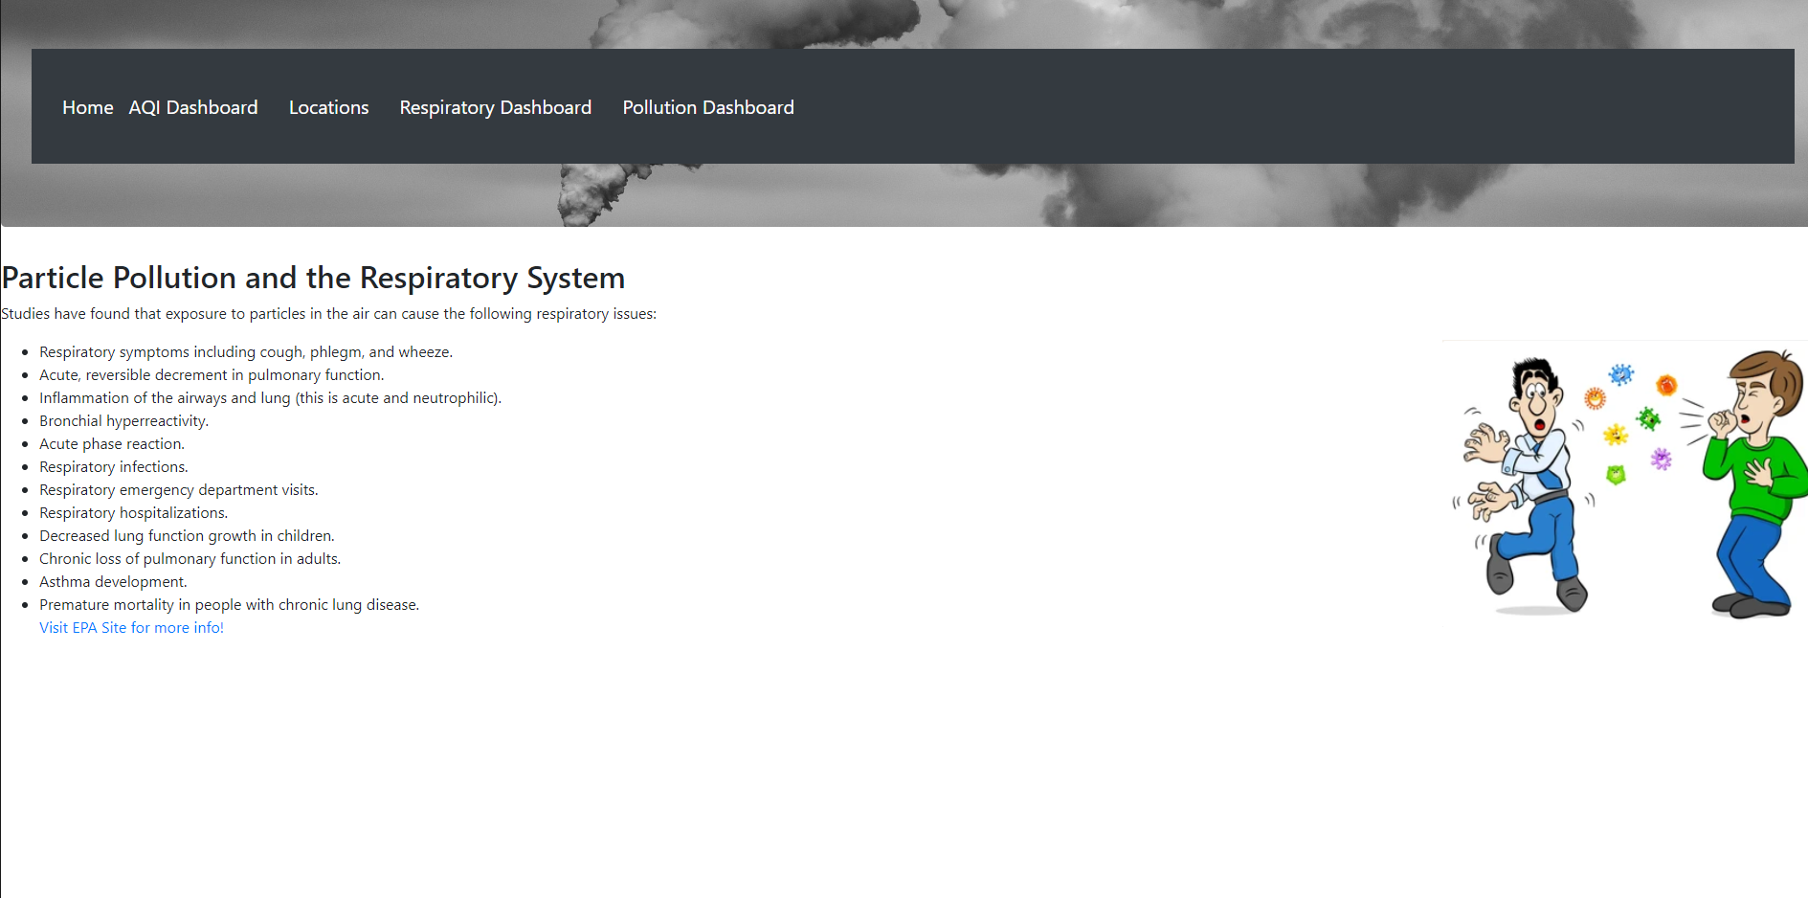
Home Page:
Gives a list of respiratory illnesses and diseases that can be caused by air pollution.
Navigation Bar showcases different charts of data.

Slide 3
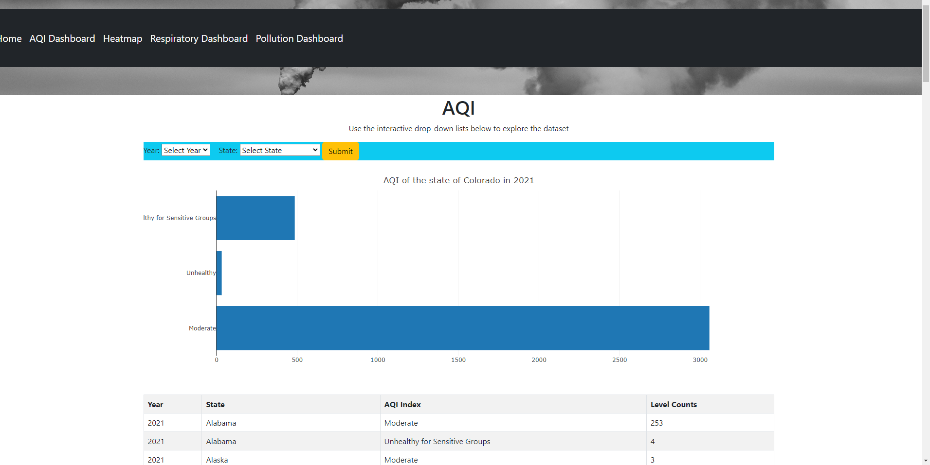
AQI Dashboard:
Question: How many Times a year does a state experience lower air quality?
The AQI Dashboard Menu Option redirects to the Plotly interactive map that allows a user to select a year and state to discover how many hours in that year the air quality fell into the various AQI index categories.

Slide 4
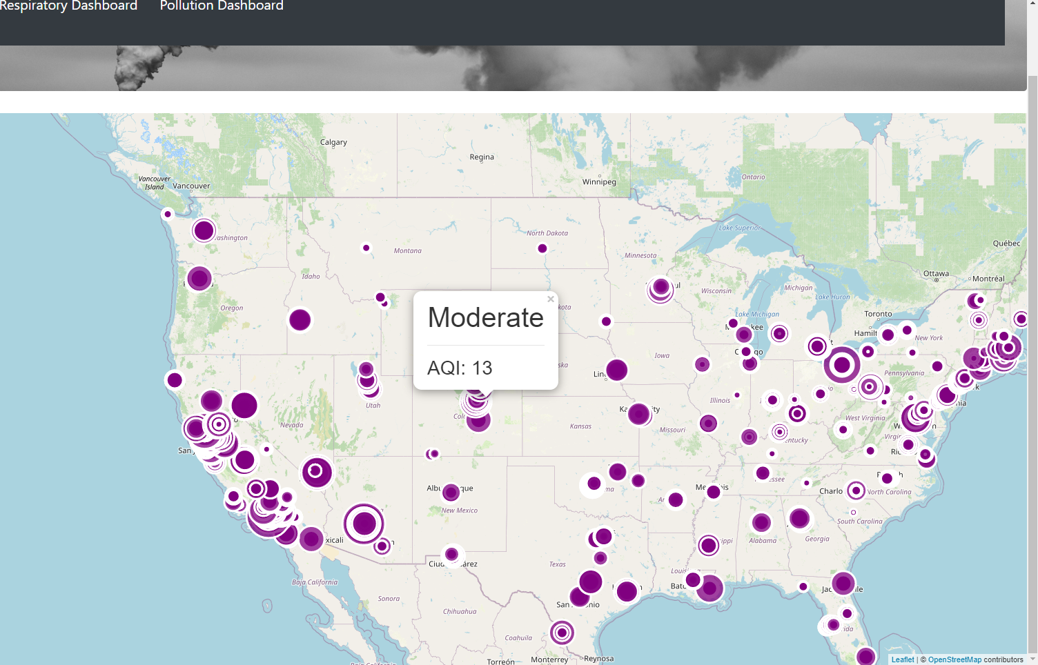
Locations:
Where are the air quality monitors and what is the reading?
The Locations menu item will take the user to a map of U.S., displaying air quality location and air quality measurement.
Note gaps in the state where there is no monitor station- resulting in skewed data.

Slide 5
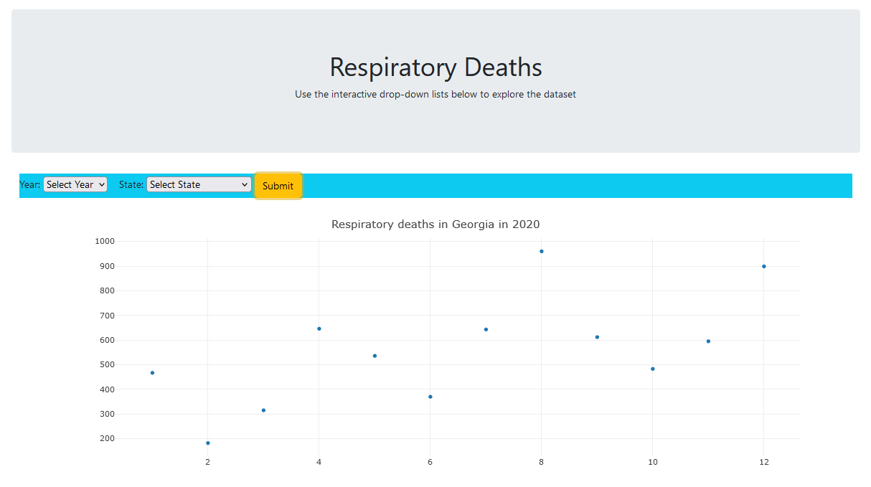
Respiratory Dashboard:
Question: How many people die each year from respiratory issues?
The Respiratory Dashboard Menu option redirects to a Plotly chart that displays the count of all respiratory deaths in a selected year within a selected state from 2020 to 2022.

Slide 6
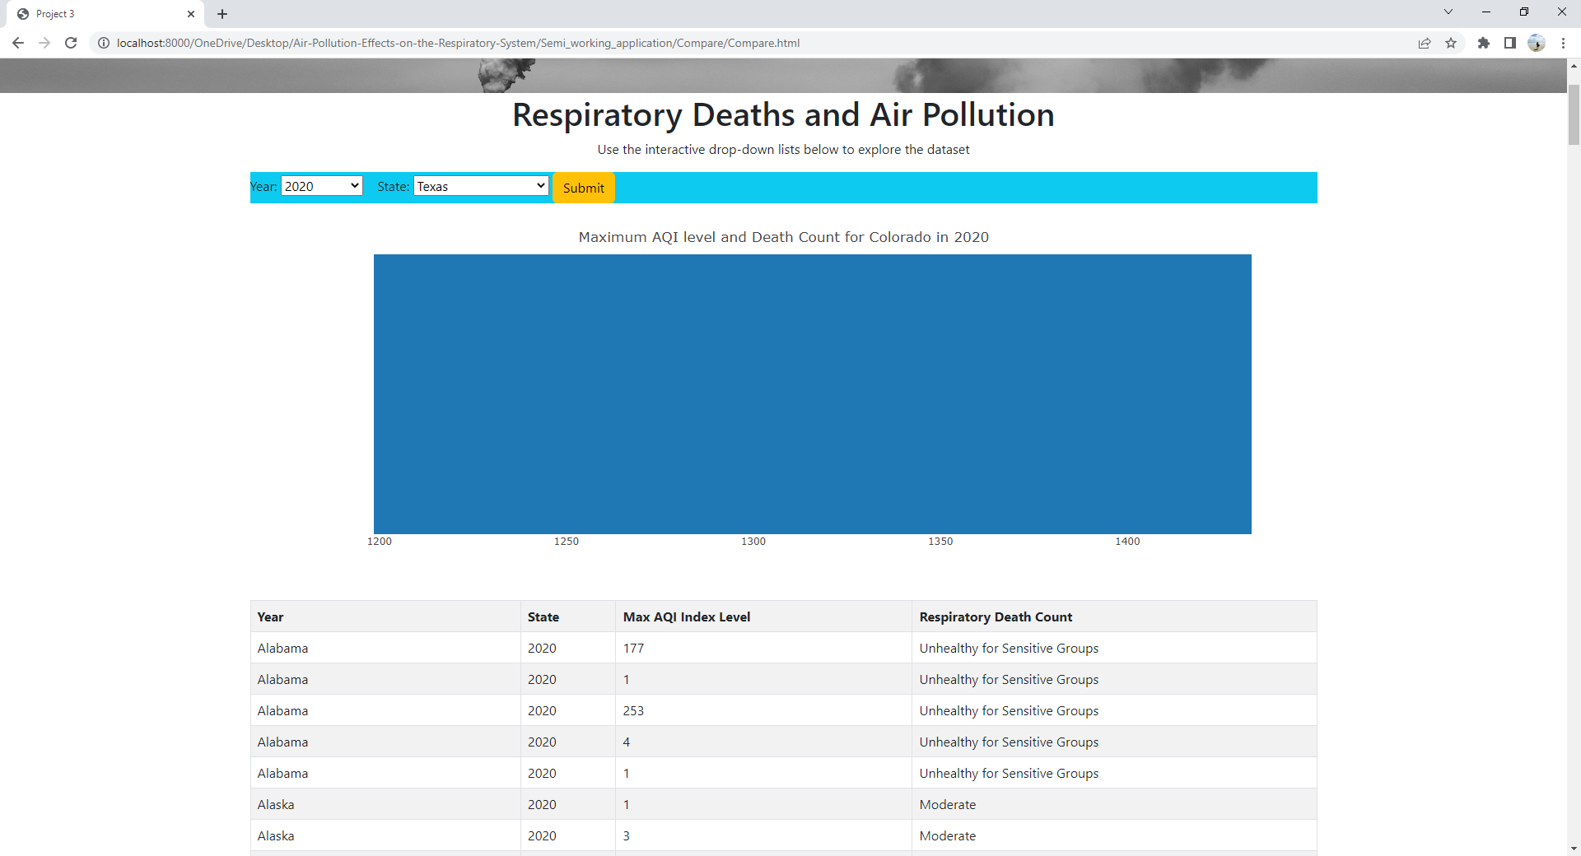
Pollution Dashboard:
Question: What is the worst air quality level a state experienced in a year and what was the total respiratory death count for that state?
The Pollution Dashboard Menu option redirects to a Plotly chart that displays the health levels in air quality and respiratory death counts by making a selection for the year and state from 2020 to 2022.

Slide 7
1- Obtained historical data on respiratory deaths in the United States for the years 2020-2022.
2- Stored historical data in a PostgreSQL Database.
3- All cleaning, joining, and aggregation occurred within the database. (See the DDL and ERD folder for details).
4- Queried the database to attempt to answer these questions.
5- Extracted the data and loaded it into JavaScript files in CSV format. (Issues occurred when JSON conversion was attempted).
Created Interactive Plotly and Leaflet visualizations for end users to explore the data.
Process:

Slide 8
Accept the null hypothesis
There were no discernable correlations between air quality and respiratory deaths in the US.
Data could have been skewed due to large areas without Air Quality monitoring stations
Population count could have skewed results. (an area with 1,000 population and 10 deaths versus an area with 1 million population and 10 deaths were counted the same).
Conclusion:

Slide 9
Data was obtained from several locations:
CDC: https://data.cdc.gov/NCHS/Monthly-Provisional-Counts-of-Deaths-by-Select-Cau/9dzk-mvmi/data
OpenWeather:
https://openweathermap.org/api/air-pollution
EPA: https://www.epa.gov/clean-air-act-overview/air-pollution-current-and-future-challenges
SOURCES:

